Slide 1
PRESENTATION SECONDARY SCHOOL

Slide 2
Questions in the chat box

Slide 3
Welcome to the
Information Evening
For
Parent(s)/Students
Incoming
2021 / 2022

Slide 4
Mission Statement
MISSION STATEMENT
Ours is a Presentation Secondary School, inspired by the vision of Nano Nagle, and in response to her we welcome and cherish girls irrespective of ability or background.
We aim to develop a vibrant community of Pupils, Staff, Parents, and Management, based on Gospel values such as justice, truth and honesty, in accordance with the ethos of the school and our agreed Code of Discipline and conduct.
We aim to assist in the development of the full potential of each girl in a pleasant and safe environment, where the dignity of each member of the School community is recognised, affirmed and valued.
We aim to awaken our girls to their true dignity and role as women in present day society. Inspired by these values we dedicate ourselves to the continual development of our Presentation School.

Slide 5
Ethos
Atmosphere of respect and dignity
Welcoming school
Academic profile of the school
Levels of care
Staff support
SNA support
Team Building
Wellbeing/Life Skills Workshops
Inclusion SEN Special Class LCA

Slide 7
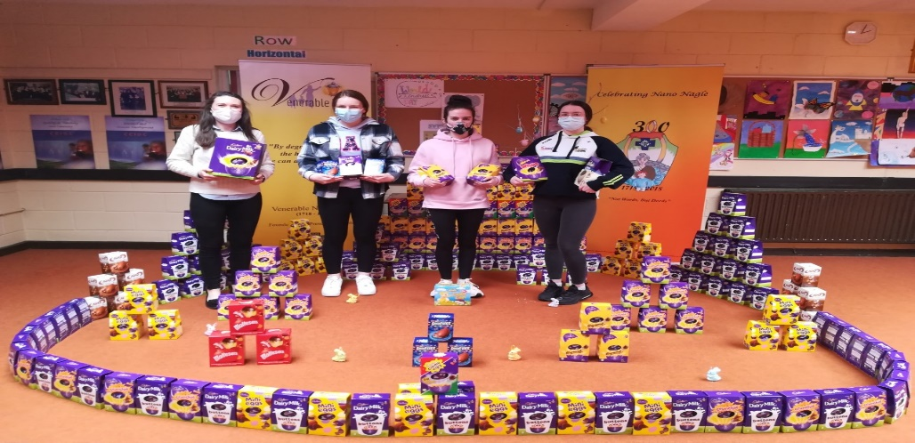

Slide 8
Induction Process
School Opens in August, week before the school officially opens
SEN students can come in
Transfer of information from Primary School

Slide 9
Managing Transition
Developing Skills Ensuring that pupils have the skills to cope with change and transition is something that teachers and parents can work on through the development of life skills.
For example, pupils can be taught skills in the following areas:
1. Basic social skills including how to ask for help, how to greet others
2. How to cope when things do not go as they expected
3. How to calm down when worried or upset
4. How to use visual means to help with organisation, such as using timetables, diaries colour coding by subject

Slide 10
Questions

Slide 11
Common areas of concern

Slide 12
We answer the questions…..

Slide 13
Earth Day 2021

Slide 14
CAT4 Testing
CAT Testing in September 2021
Maths and English
Ability profile the cohort of students
Base classes

Slide 15
First Year Surveys May pre-Covid
What have you enjoyed mostly about being in 1st Year?
Having a varied choice of subjects
Making new friends
Theme Weeks
Activities
Being treated like an adult
The nice staff
The Team Building Day
Basketball matches
Ice Cream Day
Fun Days
The things we get to do
Going on the 5K walk
Two classes of PE
Your own independence
New teachers
Going on trips
Meeting new people
More responsibility
More freedom
Sports

Slide 16
First Year Surveys May
What have you enjoyed mostly about being in 1st Year?
Longer lunch
Longer holidays
How nice all the teachers are
Experience new things
Meeting new and nice teachers
Getting a locker
Finishing one month earlier for Summer
Nice class
Different events that took place
Timetable and it was organised
Learning new things
Change from Primary
Independence
Class activities
I really like my class
Tests were not too hard

Slide 17
What did you find difficult about being in 1st Year
Being left out
Not knowing anyone
Remembering books
Remembering school books, keys, homework
Homework
Too many subjects
Not being allowed down town at lunch time
The school time
Exams
Minding books
Being the youngest
Staying on time
Learning new languages
Different classrooms each day
New subjects and not being with my old friends in class
Lockers

Slide 18
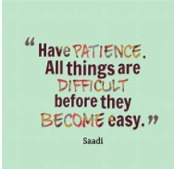
What did you find difficult about being in 1st Year
Study
The change from Primary to Secondary
I didn’t really get along with some people
Some subjects are quite difficult
February and Summer exams
Finding my way around the school
Not being able to do the subjects I wanted
All the books I had to carry
Getting to know the place when I started
9 classes a day, 9 pieces of homework
Lots of books in my bag, my back was sore at times

Slide 19
What did you find difficult about being in 1st Year
Harder exams and different teachers
Small lockers
Having different teachers for most subjects
Finding the classroom for the first week or two
Trying to learn all the subjects for exams
Some found modern languages difficult

Slide 20
Other questions asked
Did you find it easy to make friends?
Did you experience any bullying this year in school?
If you did experience bullying in school, what kind or type of bullying did you experience?
Name calling behind my back
Insulting my family
No, but I just felt left out at times
Name calling, being nasty to me
Exclusion

Slide 21
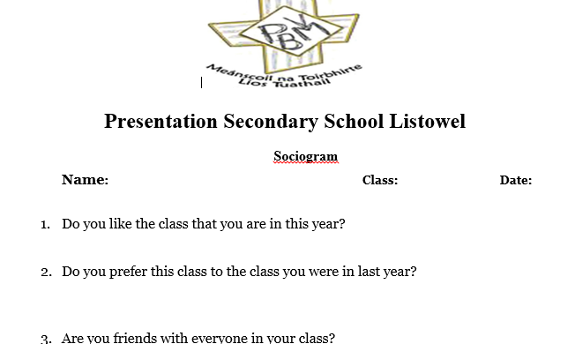
Bullying Sociogram

Slide 22
School Activities

Slide 23
Student Supports
Class Tutors and Class Teachers
Year Head
Student Support Team
5th Year Mentors
Student Council
Guidance, SEN
Principal and Deputy Principal

Slide 24
Homework
One and a half hours per night
Importance of the Journal special journal
Organisational Skills
Parent Supervision of Journal
Study Skills taught in class

Slide 25
Communication with Principal/Deputy Principal
Mobile phone numbers
Eileen: 086 7005585
Marguerite: 087 4472916
Communication the Office office@preslistowel.ie
Communication with teachers/SNA

Slide 26
Lockers
Base Room
Access Lockers in the morning, at break, lunch time and in the evening.
Lockers may be locked if students wish.

Slide 27
Lunch-time activities
Health and Wellbeing
Junior Cycle
First, Second and Third Years not allowed off the premises

Slide 28
Resumption of Extra Curricular Activities in Sept.
Basketball
Football
Fitness
Tag Rugby Badminton Athletics
Book Club Science Club
Theme Weeks – Health, , French, Reading, Friendship, Subject Dept Theme Weeks

Slide 29
Our Communication with you
Information meetings online In person Sept?
Letter to Parents Access to attendance and results online
Newsletters – Summer & Christmas
Texting School App Absence logged
Website – Twitter Facebook
Online Reports – Midterm, February & Summer
Parent – Teacher Meetings

Slide 30
Website and Twitter
School Website
Facebook page
The school Website can be found at www.presentationsecondarylistowel.ie
The School Twitter account is pressec_pss

Slide 31
Curriculum in First Year
Irish Home Economics
English Religious Ed. Exam
Maths CSPE
History SPHE/Wellbeing
Geography Music
French I.T.
German P.E.
Business Art
Science Technical Graphics

Slide 32
Subject Sampling Decision end of September 2021
Choose a language
German/French
and 3 of the following
Business
Art
Home Economics
Science
Technical Graphics
Music

Slide 33
Subject Choice Form September 2021

Slide 34
Microsoft Teams

Slide 35
New Junior Cycle
New Junior Cycle 10 subjects
Wellbeing
LP 2 Programme

Slide 36
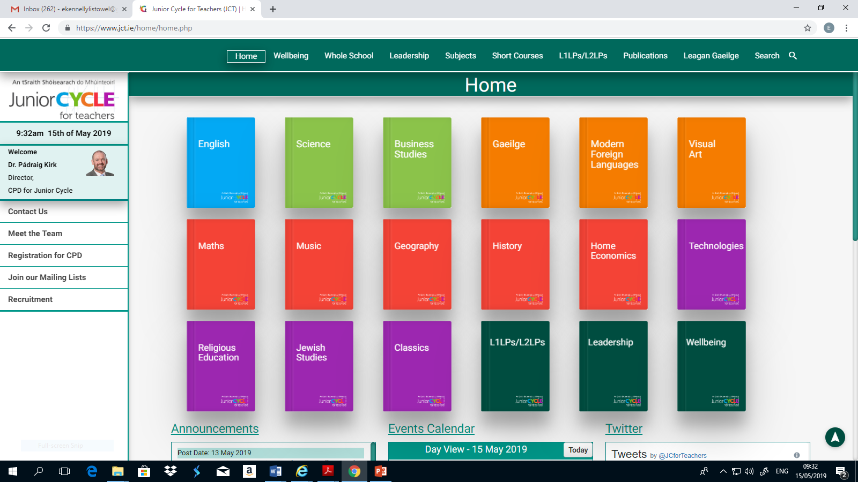
New Junior Cycle
Classroom Based Asessments

Slide 37
Engaging Parents with JC

Slide 38
Jct.ie click on Leadership, click on resources

Slide 39
Resources
jct.ie
ncca.ie

Slide 40
Uniform
Uniform available in the town – Irish sourced/ good quality.
Brown Trousers / Brown Skirt
Shirt
Brown V neck jumper
Black or Brown Shoes

Slide 41
Purchasing of Uniform
June – August Ground floor Shop
Facebook - School uniforms at utopia boutique

Slide 42
Behaviour Management
Review of Code of Behaviour 6 POINTS
Positive Affirmation – Merit Stamps / Merit Cards
Behaviour Acceptance Form
Request for permission to leave school – Use the school app Parents must be seen outside
Students arriving late to school – sign in at the office
Attendance - Absence notes School App
Punctuality
Acceptable Use Policy (AUP) Social media activity outside school hours
Anti Bullying Policy

Slide 43
Mobile Phones
‘The possession and/ or use of mobile phones at any time during the school day or on the school grounds or within the school building is prohibited’.
2.13.4 In the event of a student refusing to hand up her phone she will be withdrawn from class. Her parents will be immediately sent for. A refusal to hand over a phone may will lead to detention or suspension depending on the student behaviour
Mobile Phones / Electronic Equipment
• Mobile phones must be switched off and placed in lockers or school bags as soon as students arrive in school every morning.
• Phones MUST remain in lockers or school bags until the end of the school day.
• Students MUST NOT use their phone and/or have their phone on their person during the school day.
• Students in breach of this rule will have their phone confiscated until the end of the school day.

Slide 44
School Insurance matters
School Insurance matters
24 hour policy
I have been advised to inform parents that students who arrive on the school premises before 8.30am in the morning are the responsibility of their parents. School supervision technically begins at 8.30am.

Slide 45
Health
Any students on medication or have medical problems please talk to the Principal/Deputy Principal

Slide 46
Finance

Slide 47
Finance
Online Payment System
Way 2 Pay texting
Or pay in the office with cash

Slide 48
Finance
Voluntary Contribution:
€100.00 per Student
€150.00 per Family
Families in financial difficulty can avail of the Book Grant Application for Needy Students

Slide 49
Finance Matters
Finance Matters
Any parents who wish to avail of the Payment Plan please talk to us.

Slide 50
Transition Year
a) To consolidate and develop the learning experience of the student which has taken place during the Junior Cycle.
(b) To develop study habits more suited to Senior Cycle and Third Level
and to encourage the development of self-directed learning in all students so as to enable them to achieve at 3rd Level.
(c) To foster a growing sense of responsibility in the student for his/her
own life so that he/she may become a responsible socially conscious citizen, able to cope successfully with the demands of society and of life.

Slide 51
Senior Cycle
Irish
English
Maths
Biology
Modern Languages
Art
Home Economics
Business
Geography History
Chemistry
Physics
Accounting
Ag. Science
Design Communication Graphics

Slide 52
Leaving Cert Applied

Slide 53
Parents’ Association
Parents’ Association
Chairperson: Carmel Kelly
Board of Management 2019-2022

Slide 54
Board of Management
Trustee Nominees
Chairperson: Mr. Shay Downes
Ms. Mary Frances Behan
Marie O’Connor
Mr. Ed Hayes
Parents’ Association
Ms. Debbie Hannan
Ms. Elaine Frizell
Staff
Ms. Norma Dowling
Mrs Margaret Daly

Slide 55
New Principal October 2021
Katherina Broderick
Currently Principal in Presentation Castleisland

Slide 56
THANK YOU

