Slide 1
Transition year
2024/25
Information evening 26th August 2024

Slide 3
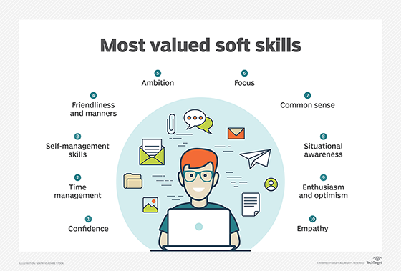
WHY TRANSITION YEAR?
Opportunity to make new friends and mix with other groups
Break from high-stakes examination stress before entering Senior Cycle
Varied teaching and assessment methods
Subject sampling
Participation in drama, mini-companies
Finding new interests and developing new skills (personal, social, practical and artistic)

Slide 4
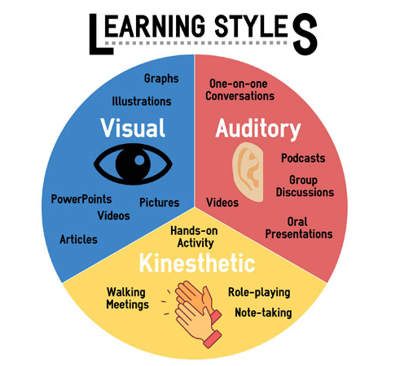
WHY TRANSITION YEAR?
Make better subject choices for Leaving Certificate
Explore the working world & possible careers.
Develop a mature, independent attitude to learning
Extend their repertoire of learning styles.
Extend the learning experience beyond the classroom
Maturity moving forward into Senior Cycle

Slide 5
CORE SUBJECTS
English
Irish
Mathematics
Religion
Science
Digital Skills
Career Guidance
European Languages & Culture Studies
Geography
Wellbeing
Music
SPHE
PE

Slide 6
School week format
Monday, Wednesday, Thursday: 9am-4pm
Tuesday: Work experience all day, commencing Tuesday 1st October
Friday: 9am – 1:15pm

Slide 7
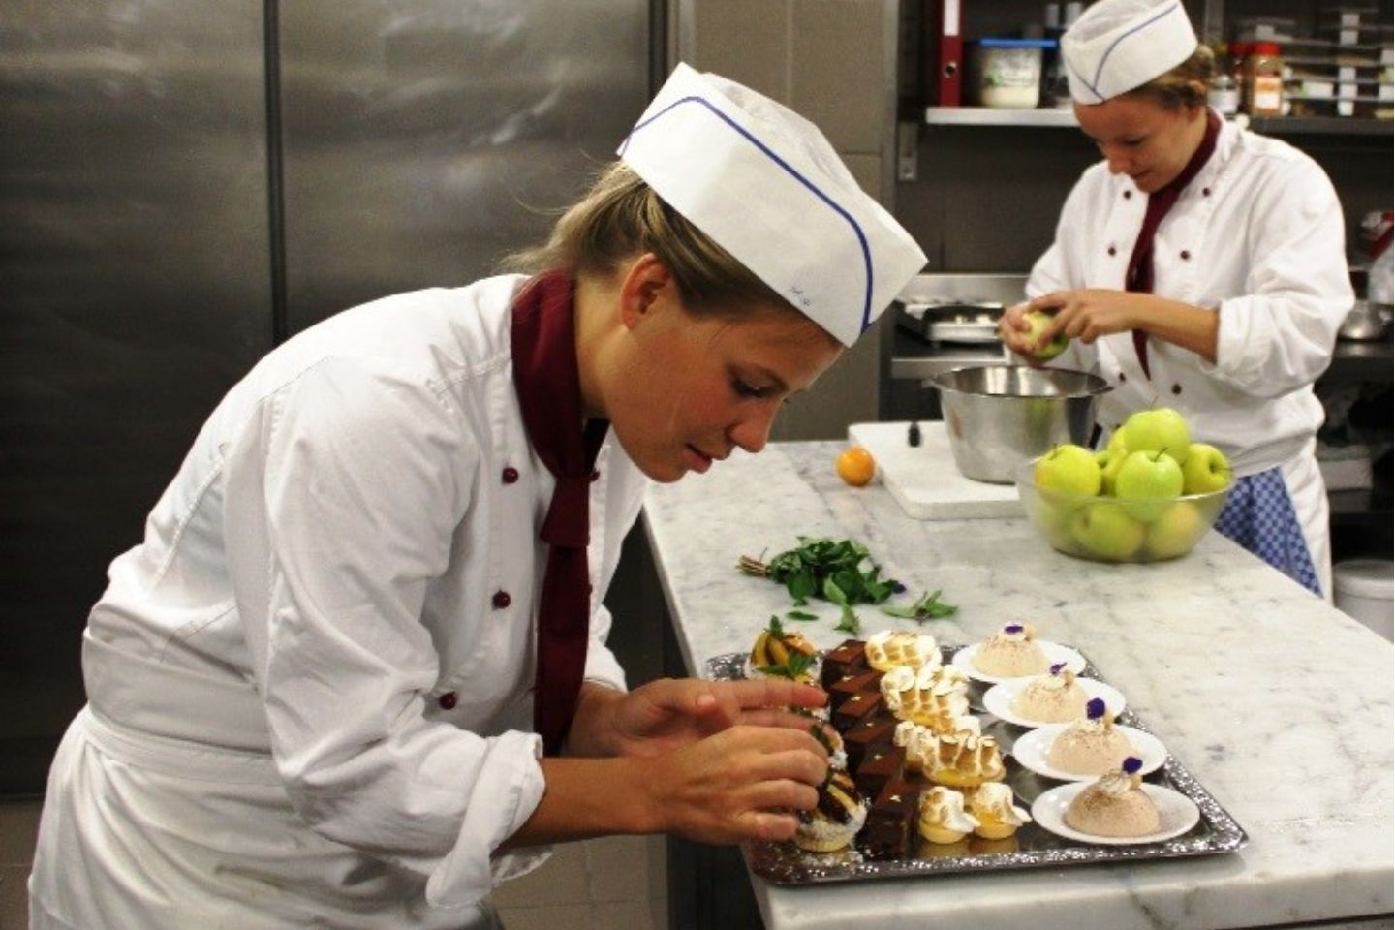
Subject sampling
Engineering
Law Ed
Drama
Art & Camera Studies
Culinary Skills
Business & Enterprise

Slide 8
Medical Information
We must be notified of any medical conditions/medication needed

Slide 9
Calendar of events
We have an extensive range of programmes, certificates, activities and workshops organised for the year and more will be added throughout the year when they become available by various organisations.

Slide 10
23rd August Friday Mentoring 1st Years
3rd/4th September Tues/Wed Burren
Mentoring & Team building for first year TBC
10th September Tuesday Ballyhass
17th September Tuesday Ploughing Championships
18th September Wednesday STEM Passport for inclusion
September 22nd - 28th Listowel Races Race Week
23rd September Monday Bernard Casey
30th September Monday Driving School
7th October Monday Bodhran workshop
10th October Thursday Special Effects make up class
14th October Monday Law Ed
17th October Thursday Open evening
17th October Thursday LGFA coaching & refereeing course MAX 20
23rd October Wednesday STEM Passport for inclusion

Slide 11
TY Activities

Slide 12
mentoring
The transition year students have already completed mentoring training, which they will use to mentor first year students throughout the year, helping them to settle into secondary school in their transition from primary school.

Slide 13
mentoring
They will also take part in a paired reading course over the year with the first year students, which is proven to improve the literacy of all students involved in the programme.

Slide 14
Burren outdoor adventure centre
Overnight stay, two days of activities
Tuesday 3rd September & Wednesday 4th September
Team building
Cooking together – must buy ingredients

Slide 15
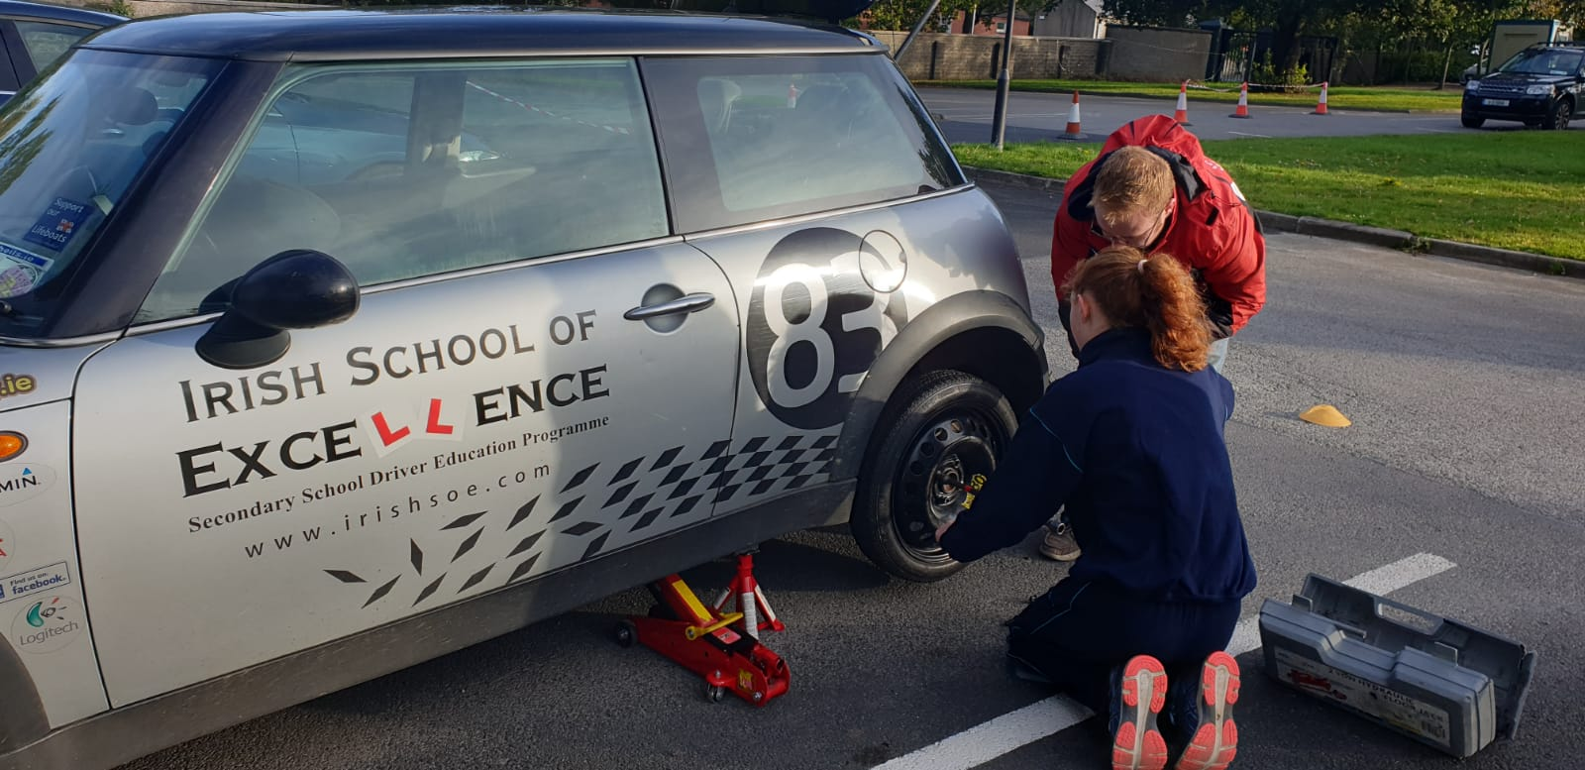
Driving school

Slide 16
GAA Future leaders
Fundamental movement skills (FMS)
Coaching of Hurling/Football
Refereeing
Sports Administration
Sports Journalism
Performance Analysis
Nutrition
Wellbeing
Event Management
Irish History and Culture

Slide 17
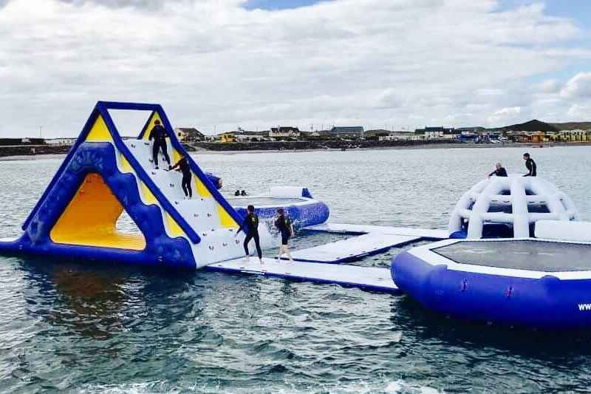
Splash sports castlegregory

Slide 18
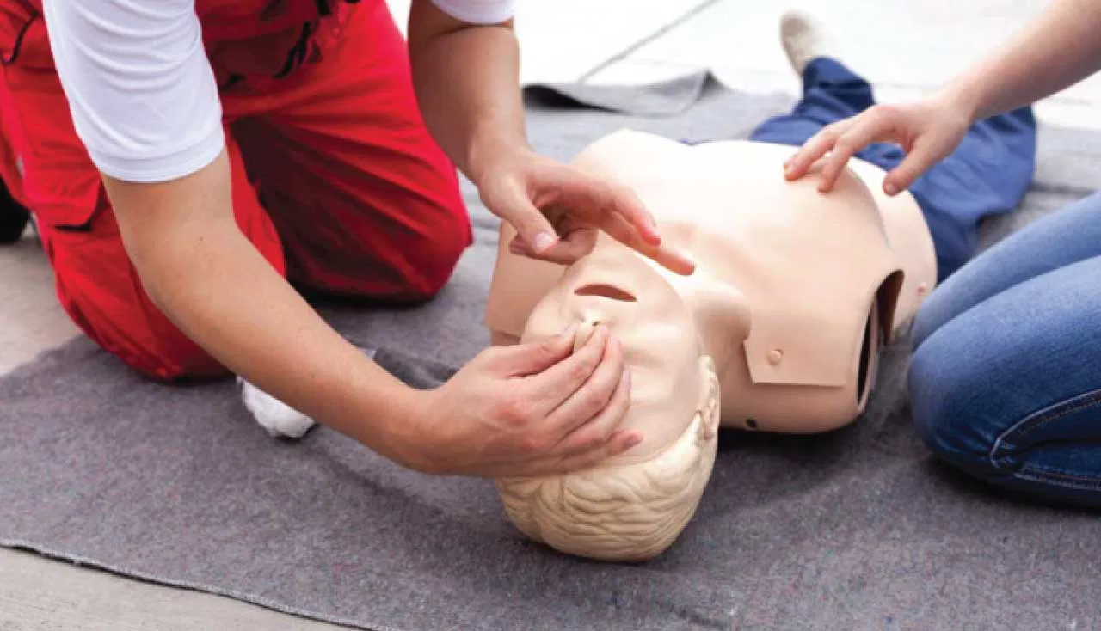
CPR COURSE & QUALIFICATION

Slide 19
Film making classes

Slide 20
dance
Create your own dance routine
Free style dance
Zumba
Jiving
Hip Hop

Slide 21
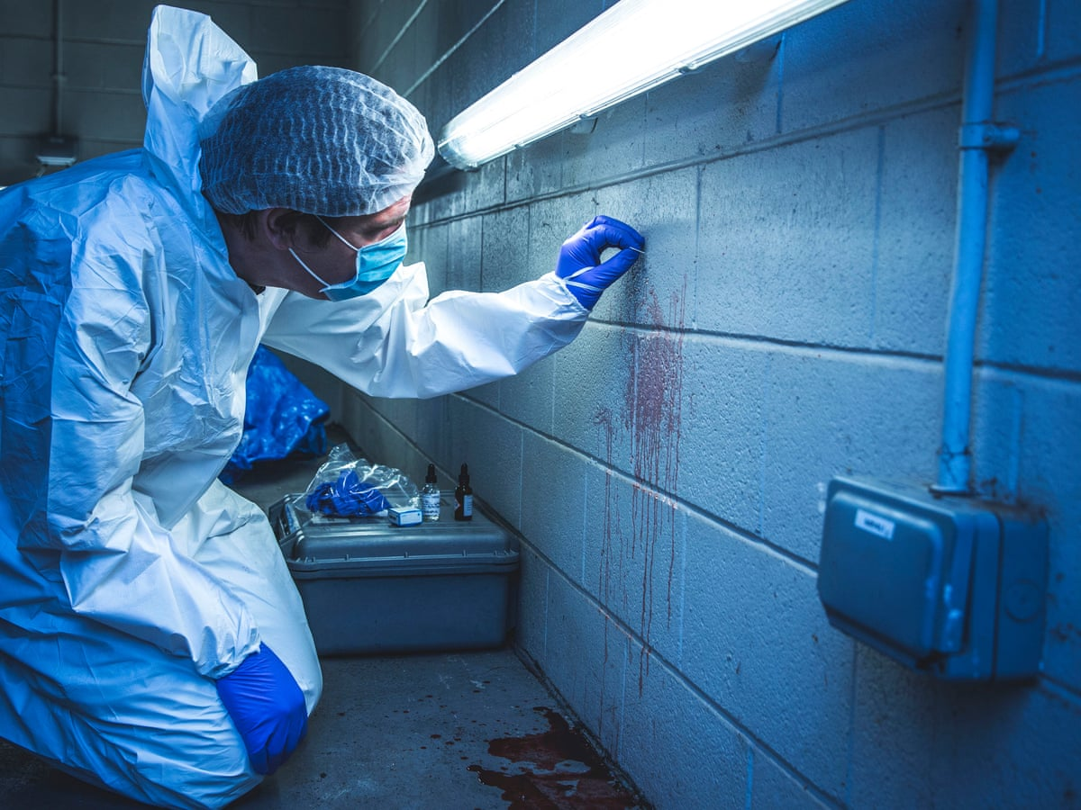
Forensics workshop

Slide 22
Kerry college of further education
Career preparation
Health & fitness

Slide 23
CV SKILLS
CV Skills
Presentation Skills, Interview Skills, Time
Management and Study skills, Computer/ IT Skills
Career Guidance, 'How-to' guides
Leaving Certificate Subject and College Course guides from University students
Career stories from working professionals.

Slide 24
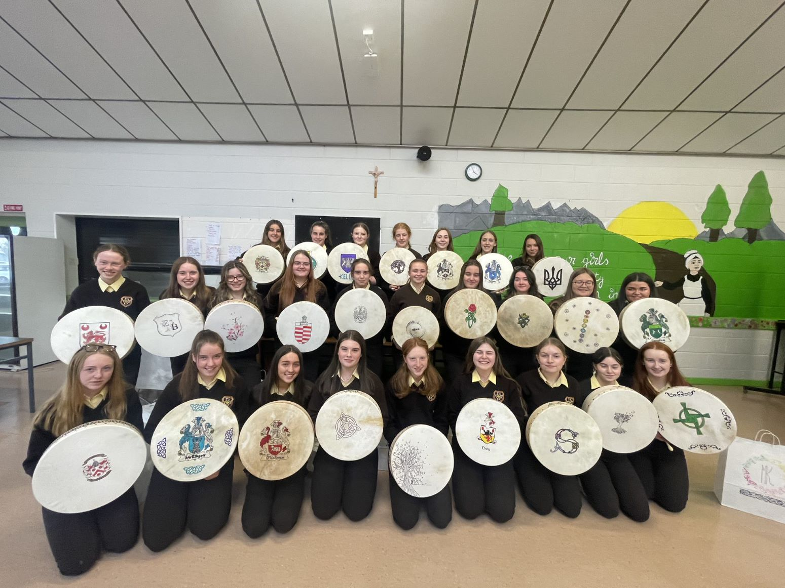
Bodhran making

Slide 25
Special Effects Make-up workshop with professional makeup artist Andrea Murphy

Slide 26
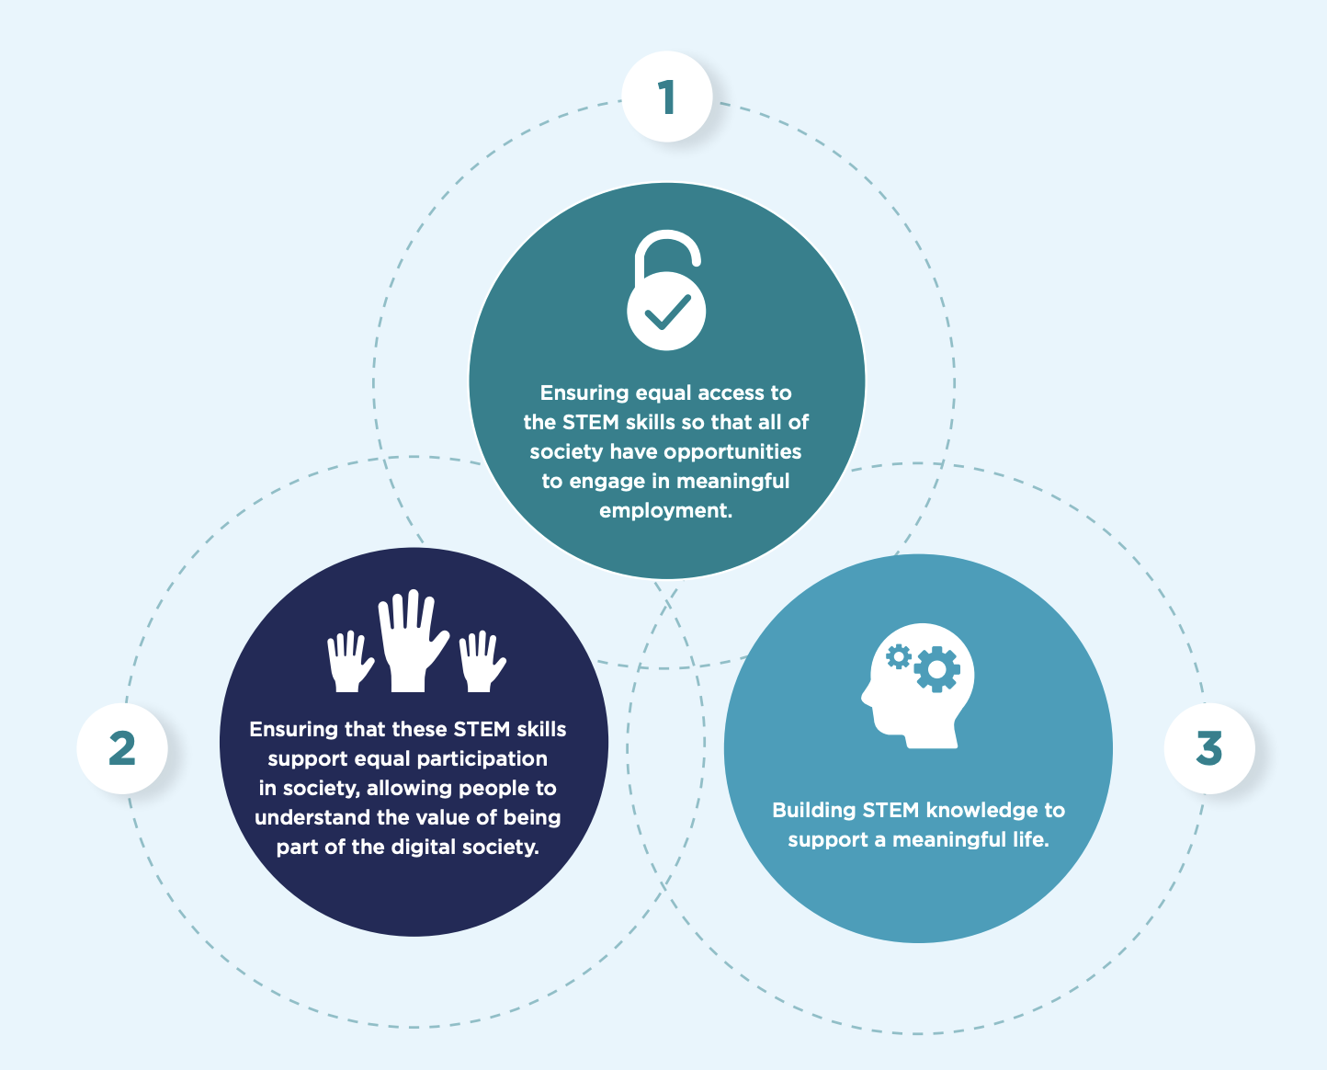
STEM PASSPORT For Inclusion

Slide 27
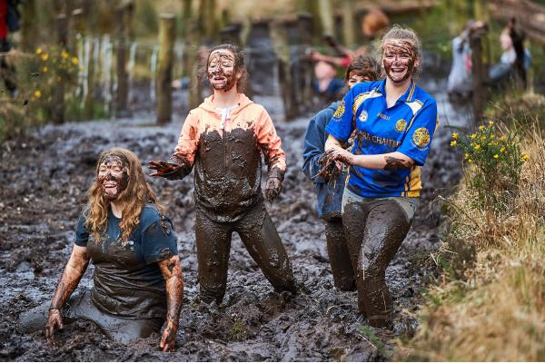
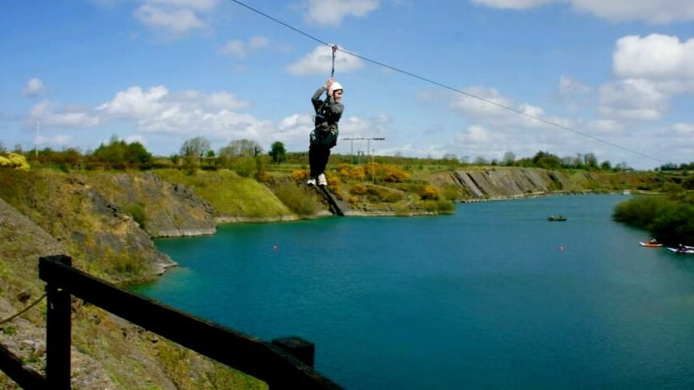
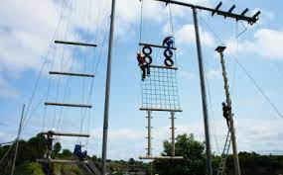
Adventure centres

Slide 28
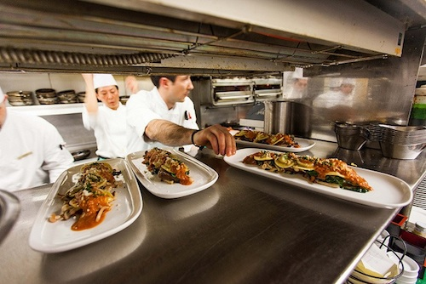
Hospitality certificate

Slide 29
Bernard casey drama workshop

Slide 30
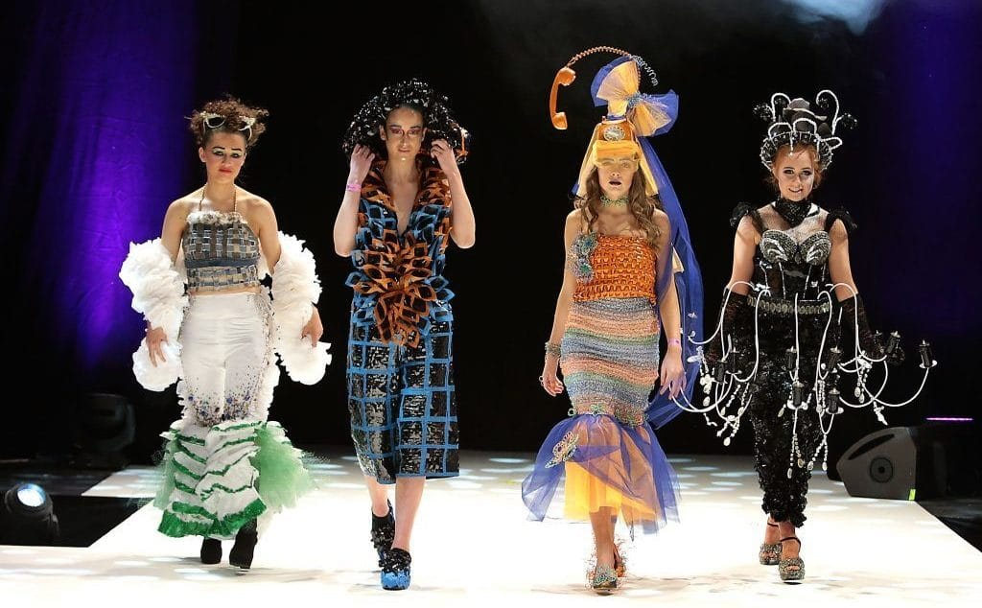
Junk kouture
Students will be participating in create their junk kouture design, in the hope of submitting some to the national competition and displaying all of their efforts in the school.

Slide 31
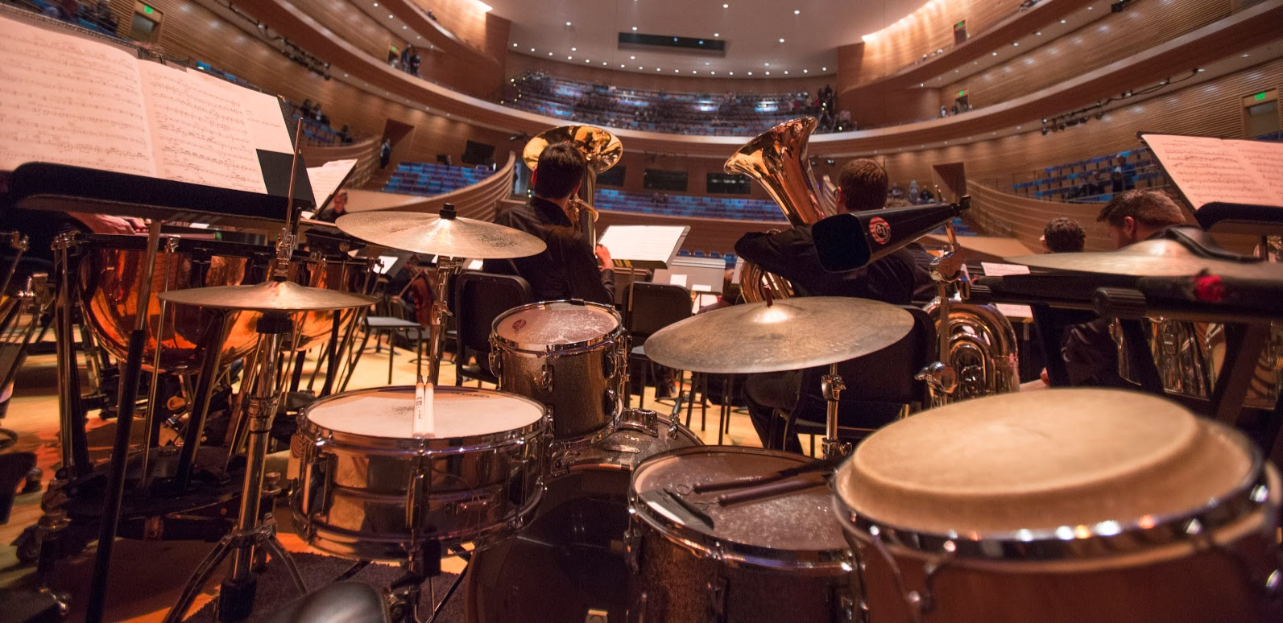
Percussion workshop

Slide 32
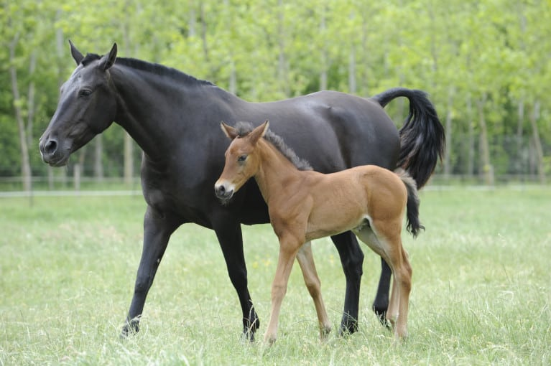
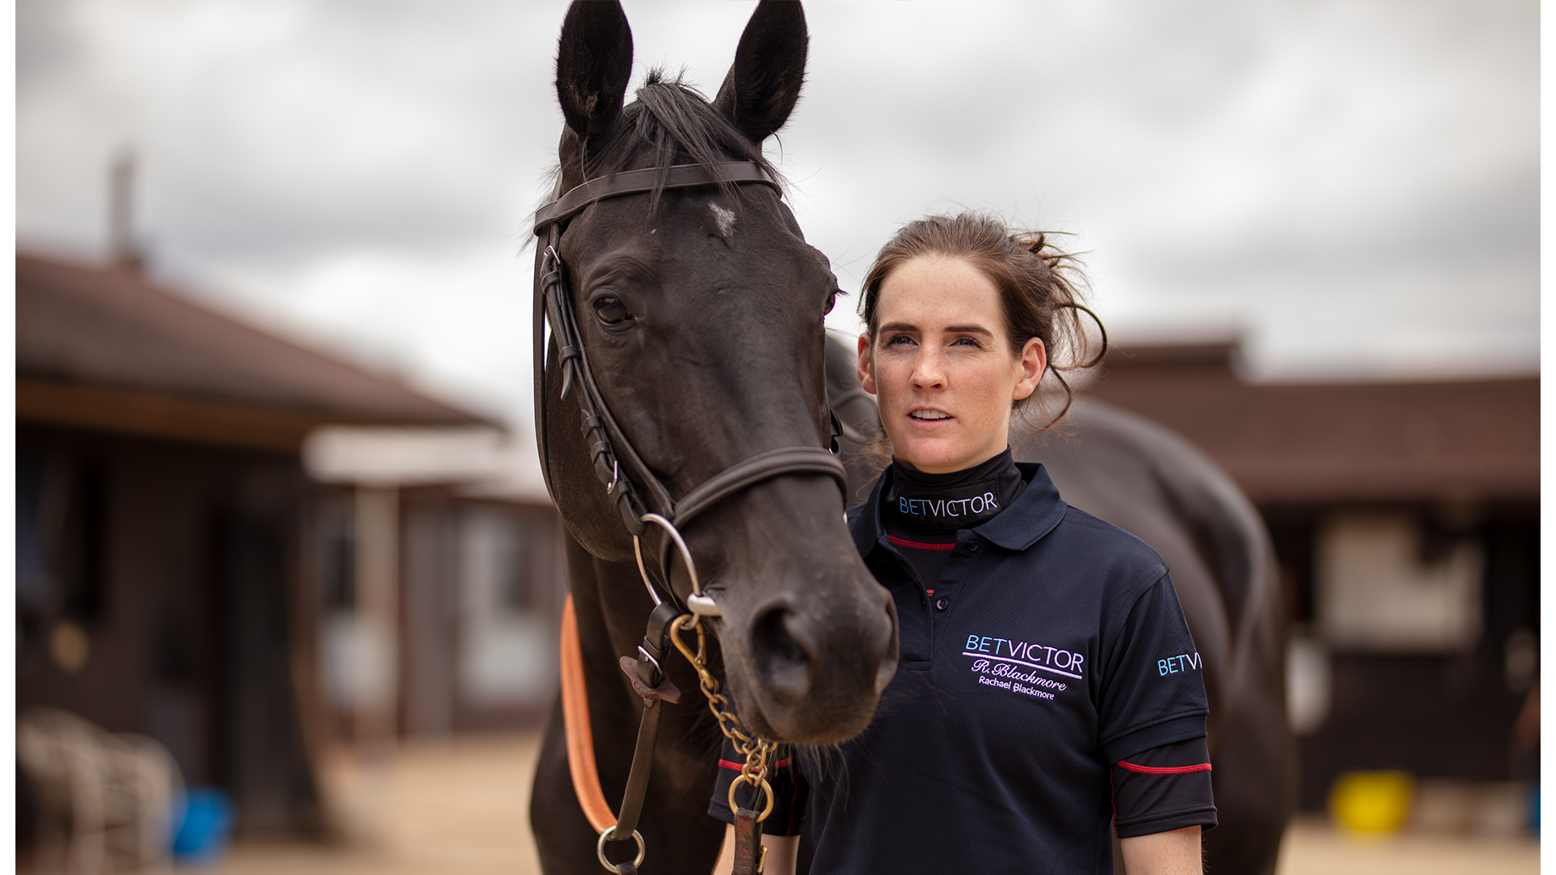
From foal to race – equine ireland

Slide 33
Forensics workshop

Slide 34
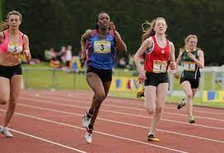
The girls squad

Slide 35
Personal safety workshop

Slide 36
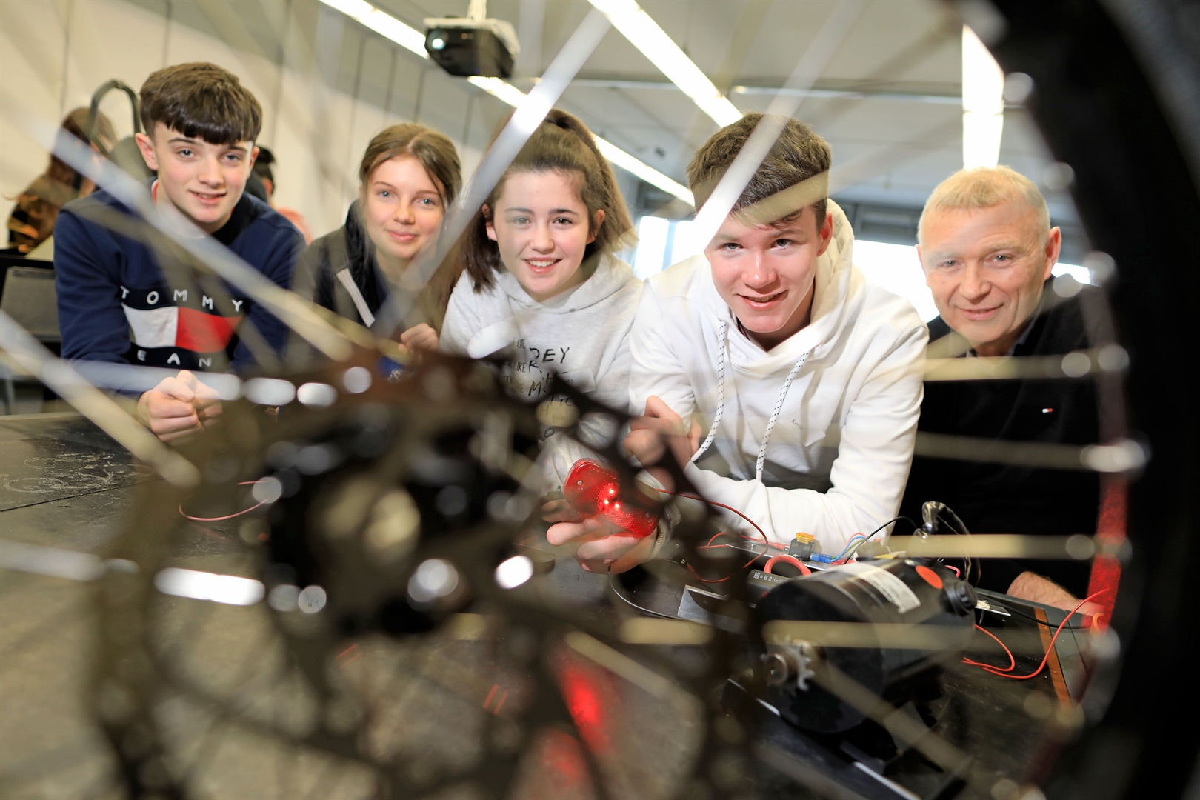
Engineers Ireland programme

Slide 37
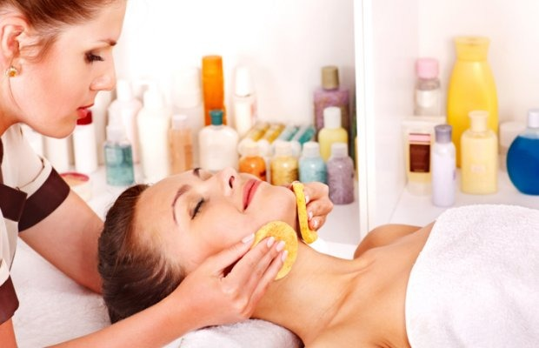
Beauty therapy workshop

Slide 38
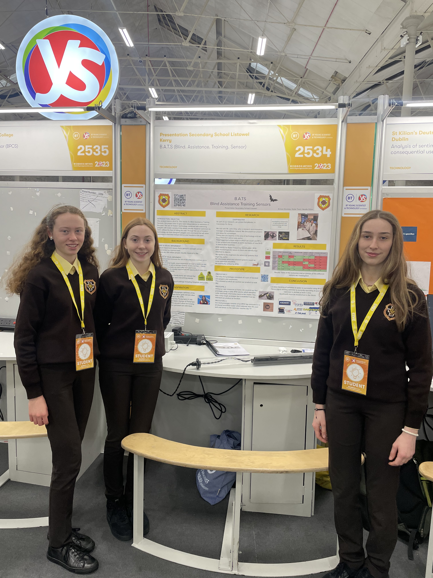
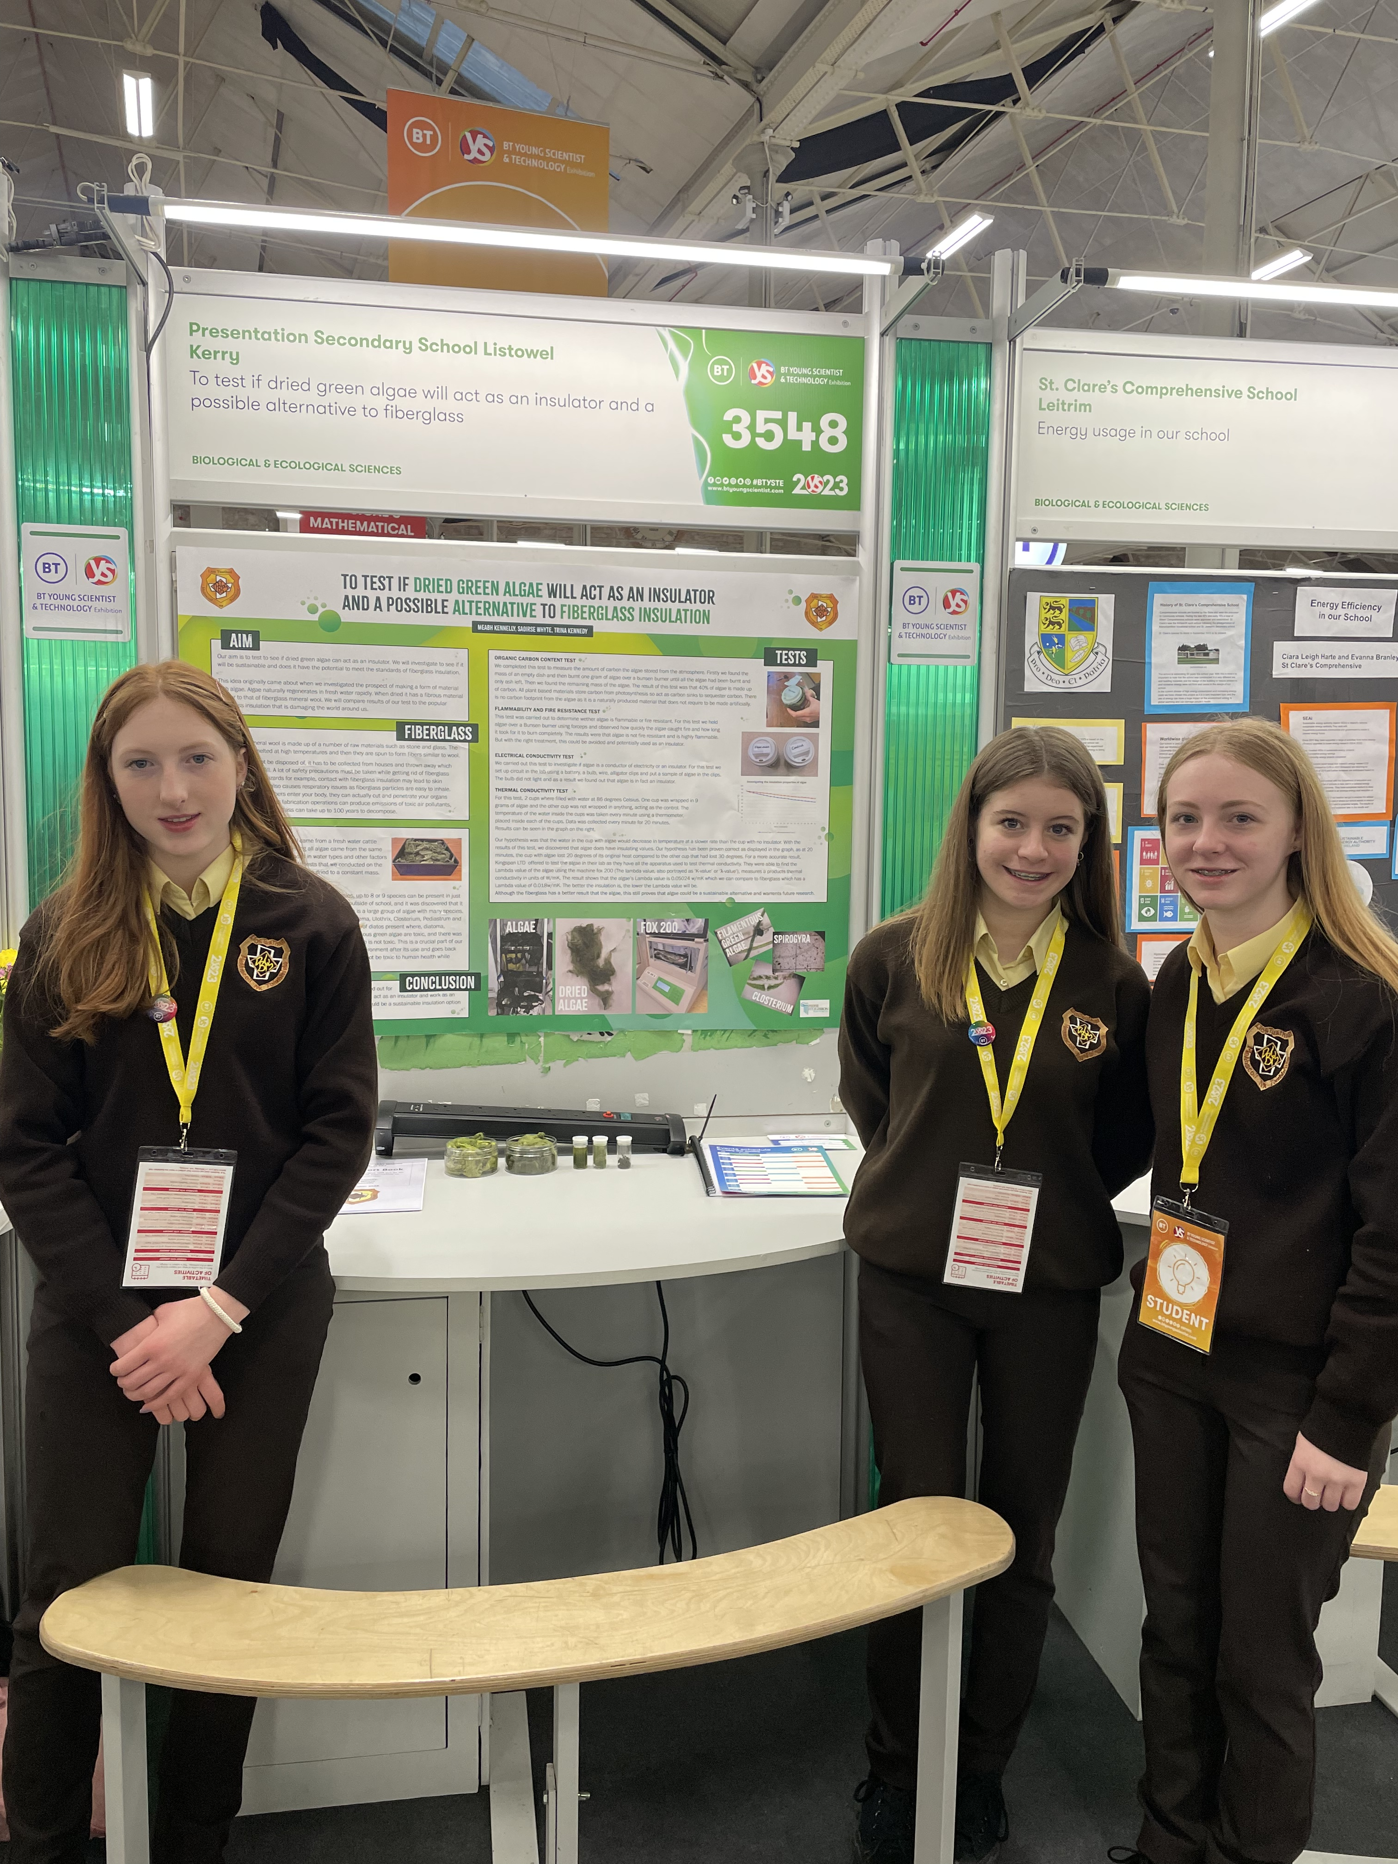
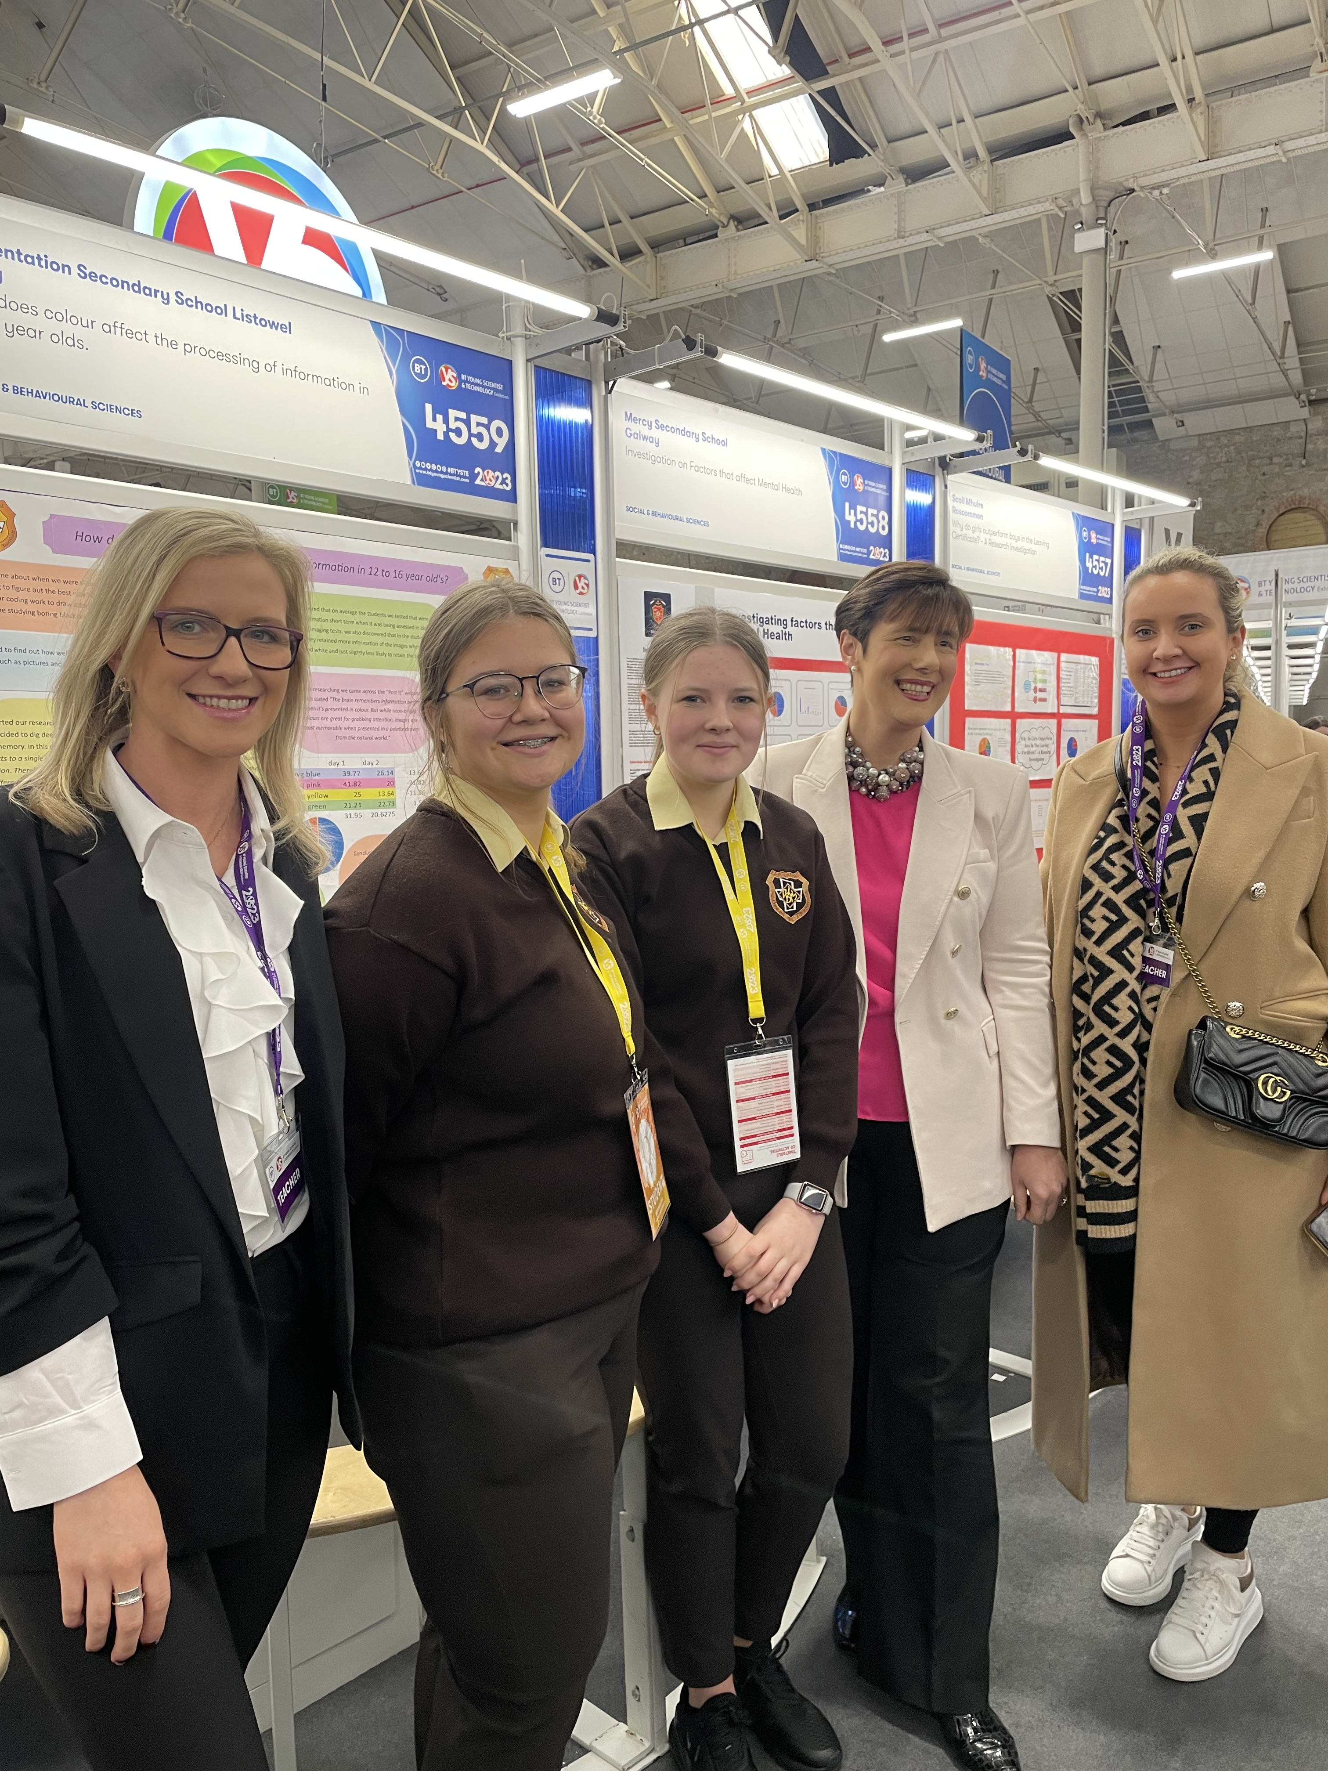
BT YOUNG SCIENTIST

Slide 39
Foreign trip

Slide 40
Survey for foreign trip
Parents and Students are surveyed each year about the possibility of offering in an optional foreign trip.

Slide 41
TY Specific modules
Work Experience
GAA Future Leaders Programme
ICT courses
Food & Beverage Skills Accredited Hospitality Course
AWARE Mental Health Four Week Course & Certification
B.T. Young Scientist Competition
Drama & Media Studies – Performance
Junk Couture Fashion Design Competition
SafeFood Qualification

Slide 42
Work experience
2024/25 features a one day a week requirement (Tuesdays) for students to attend work experience.
UHK offer a nursing and diagnostic placement
An Garda Síochána TY Placement
Solicitors of the Future Programme
Look Into Law Online Programme
Local placements encouraged and supported also.
Garda vetting forms are available from the school now, should your work experience placement require this.

Slide 43
Transition year one off events
Transition Year in Presentation Listowel is an evolving, dynamic and ambitious programme.
As a result, this element of Transition Year changes from year to year in an effort to support the collective interests and talents of the students involved.
We endeavour to present the best available programme to Transition Year students each year.

Slide 44
Costs
Not included included in costs are:
Overnight trips
Microsoft Dream Space visits (TBC)
Foreign trip

Slide 45
Work Experience
One Day each week –Tuesday
Begins 1 October 2024
A Minimum of three placements recommended

Slide 46
Work Experience – Some Examples
Solicitor
Primary School
Creche
Hairdresser /Beauty Salon
Opticians/Pharmacy
Hospital -RCSI -UHK
Radio Kerry
Deloitte –Online
Kostal
Veterinary Practice
Dog Grooming
Charity Shop
Nano Nagle
Insurance Companies
Farming

Slide 47
Assessment and Monitoring in Transition Year

Slide 48
Credit system
Credits are awarded for the various components of the TY Programme

Slide 49
Student monitoring and Assessment
Parent/Guardians will receive November, February and Summer reports detailing their daughter’s progress in Transition Year.
Parent/Guardians will be invited to attend parent-teacher meetings and information evenings.
Parent/guardians can contact Ms Kennedy or Mrs. Dowling through the school office at any time. Telephone 06821452
Work experience log book will be signed by the employer each week.
Failure to attend without notice will be treated as a breach of the code of behaviour.

Slide 50
Student Portfolio presentations Assessment
Students are given an opportunity to reflect on their experiences and learning
Students prepare and present a presentation to members of staff
The reflective journal kept by the students forms part of the presentation
The presentation forms part of the assessment processes in the TY programme
Parents and students are informed of the results
It encourages accountability and acknowledges students work

Slide 51
Progression and Developments in the Transition Year Programme

Slide 52
Numbers Nationally in TY Double in Twenty Years
TY Available to All Schools since 1994
60,000 students in TY in 2023/2024
80% of Junior Cert students entered TY in 2023/2024
Increase from 40% to 80% in 20 years

Slide 53
New Developments in the TY Curriculum
A renewed focus on the knowledge, skills and competencies students should learn during
Transition Year

Slide 54
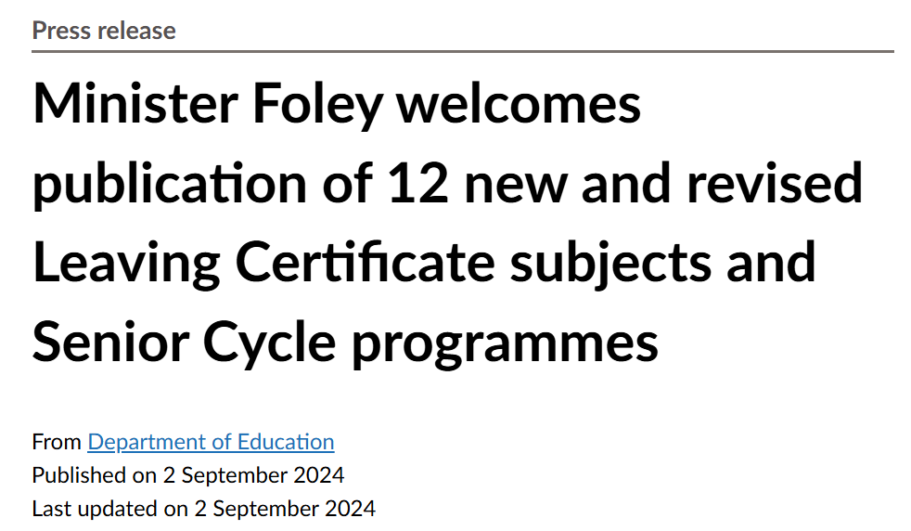
The Context of the new developments 2024

Slide 55
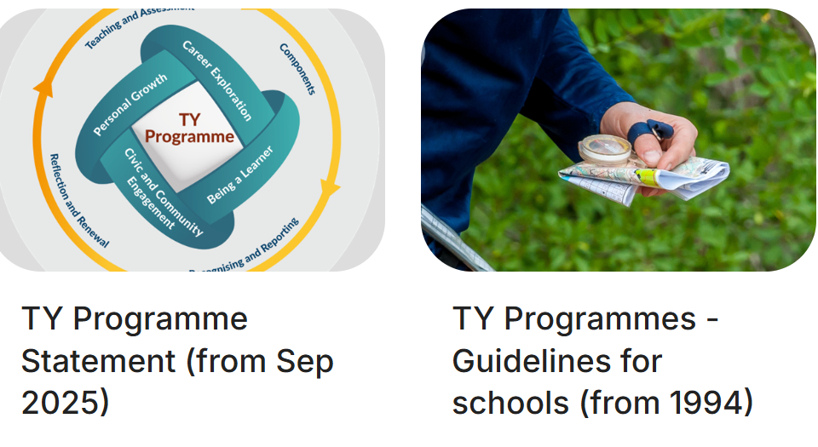
TY Programme Statement 2025 Last Updated in 1994

Slide 56
Presentation Secondary School Listowel moves ahead with new Recommendations
Staff participating in the consultation process for the new Transition Year programme since 2023
New developments in the timetable for 2024/2025
Developments underway ahead of the national implementation of the new Transition Year statement in September 2025

Slide 57
AN Overview of the TY Programme Statement 2025
The parameters to support schools in developing their TY programme are described through Student Dimensions and Curriculum Dimensions .

Slide 58
Student Dimensions of the TY Programme The Learner Experience
Personal Growth –Social and Emotional
01
Being a Learner-discover learning styles that suit the student
02
Civic and Community Engagement
03
Career Readiness- explore future pathways and gain work experience.
04

Slide 59
Curriculum Dimensions of the TY Programme
Components- a combination of core learning, subject sampling, TY specific modules and many other experiences
Teaching and Assessment- Appropriate and effective teaching methodologies and a variety of assessment strategies.
Recognising Achievements-reporting and celebrating achievements
Reflection

Slide 60
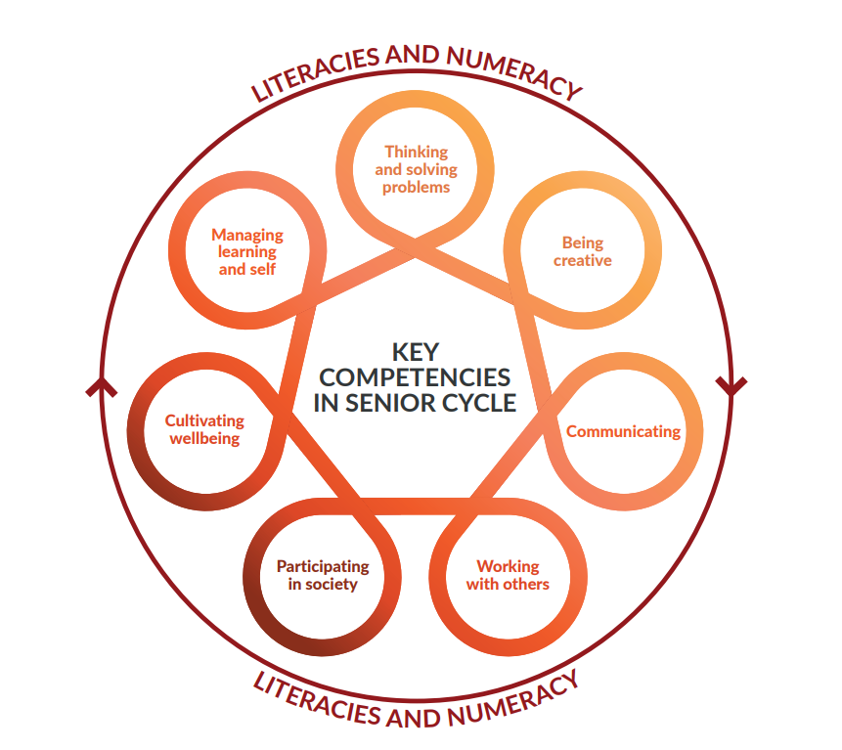
Key Competencies of Senior Cycle form the foundation of all Senior Cycle Programmes
Managing learning and self
Thinking and solving problems
Being Creative
Communicating
Cultivating Wellbeing
Working with others
Participating in Society

Slide 61
Your support.....
Encourage your daughter's participation in all activities
Acknowledge what efforts are made to ensure a positive experience for them
Encourage creativity and exploration of new experiences and friendships.
Career development – involvement of parents is welcome.

Slide 62
Thank You for Joining Us
For further information please contact our Team
Norma Dowling and Catherine Kennedy on 068-21452
Slán Abhaile

